Slide 1
Chicken Egg Production

Slide 2
Learning Goals
So you want to buy some “layers?”
Do you have the appropriate food/water/space?
Lighting system?
Know how to identify who’s laying?
Troubleshoot why some may have stopped laying
What’s inside the egg? What is each part’s function?

Slide 3
Fun Facts about Layers
On average, at 6 months of age, hens can start laying
Lays one egg per day
Takes 26 hours to fully form an egg inside the chicken
She will lay for 3-4 years
Production will decrease each year
Shell quality will decrease each year
Egg size will increase each year

Slide 4
Diet
Feed must by high in Calcium to help harden shells
Get feed from feed store, appropriate for the level your birds are at
FEED | PROTEIN LEVEL (%) | AGE OF BIRDS | FEED INTAKE/10 BIRDS/ AGE PERIOD
Chick starter | 20-22 | 0-6 weeks | 20-29 lbs
Pullet grower | 14-16 | 6-20 weeks | 120-130 lbs
Layer | 15-18 | 20 weeks on | 18-24 lbs/week
All purpose* | 16 | All ages

Slide 5
Quick Quiz #1
True or False?
Chicken feed will have the same amount of protein for chickens of all ages.

Slide 6
False!
Chickens need different amounts of protein at different stages of life.
FEED | PROTEIN LEVEL (%) | AGE OF BIRDS | FEED INTAKE/10 BIRDS/ AGE PERIOD
Chick starter | 20-22 | 0-6 weeks | 20-29 lbs
Pullet grower | 14-16 | 6-20 weeks | 120-130 lbs
Layer | 15-18 | 20 weeks on | 18-24 lbs/week
All purpose* | 16 | All ages

Slide 7
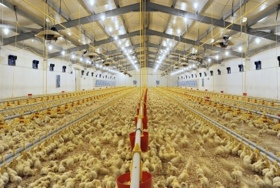
Light Management
Chickens require at least 14 hours of daylight
Longer the days=more production
Need 60 Watt bulb for every 100 ft², hanging 7 ft above birds
Gradually lengthen amount of longer days as they get to full production

Slide 8
Space Requirements
Need open space, perches, & nesting boxes
For every hen, need 1.5 ft² in the hen house
If you have an outside area for them to roam, allow 2 ft² per hen.
Preferable for them to be in the hen house at night to keep them safe from predators. (raccoon, snakes, fox, mongoose, hawk)

Slide 9
Quick Quiz #2
Which of the following is NOT necessary for chickens’ well-being?
A. Balanced feed
B. Clean, fresh water
C. Soft bed to rest in
D. Long days

Slide 10
C. Soft bed to rest in
This is not needed; chickens prefer to perch on a branch or piece of wood.
They do like their nest (where they lay their eggs) to be soft, but they don’t
rest there.

Slide 11
Signs to know whether hens are laying:
Are the combs/wattles bright red? (in some breeds)
Is the yellow pigment fading in vents, face, then feet?
Abdominal fat will be less in layers

Slide 12
Reasons for laying to cease
No fresh, clean water (or not enough)
Wrong kind of food (or not enough)
Not enough hours of daylight
Birds have parasites?
Other symptoms going on with the flock?

Slide 13
Parts of the Egg
The air cell is formed as the egg cools from
106 degrees inside the hen’s body. Causes the
contents inside the egg to contract, leaving
an air pocket. The older the egg, the larger the
air cell.

Slide 14
Egg parts, continued
Shell– 7,000 pores to allow gas exchange; CO₂ & moisture given off, O₂ & atmospheric gases go in.
Inner/outer membrane– keeps bacteria out and prevents dehydration
Albumen (egg white)– liquid where embryo would develop; has protein for embryo’s proper development
Chalazae—chords (mucin fibers) that hold the yolk at the center. Fresher the egg, more prominent these are.
Yolk—source of food; contains all the fat
Germinal disc—where female’s genetic material is; where sperm would enter egg to fertilize.

Slide 15
Quick Quiz #3
If a baby chick was developing inside an egg, what would be it’s primary food source before hatching?

Slide 16
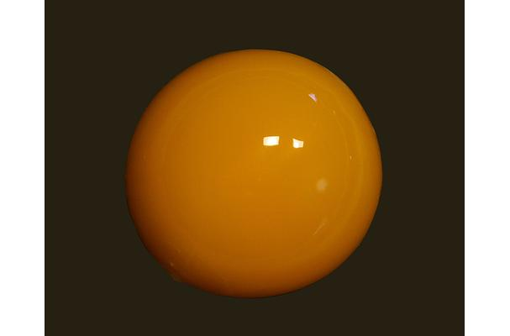
The YOLK!

Slide 17
What happens if my hen’s eggs are not fertilized?
Need to be incubated 21 days, if you want to hatch them as baby chicks.
If you are selling eggs, it’s okay to eat a fertilized egg. Once they are refrigerated, the embryo will not develop.
If a hen mates before the egg is formed, it’s possible that she lay fertilized eggs for a week, even if she mated once.
Can tell if an egg is fertilized by “candling.” If it looks opaque, it’s fertilized. Look for blood spot & embryo in a fertilized egg.

Slide 18
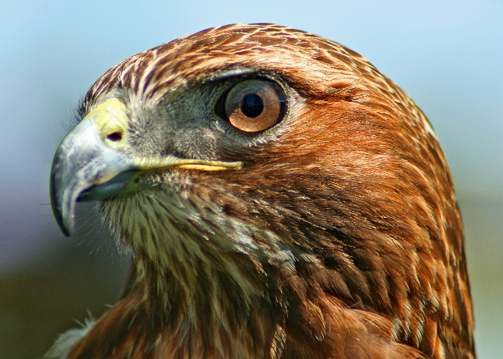
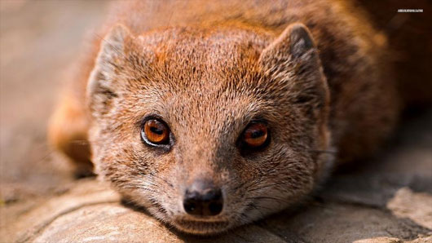
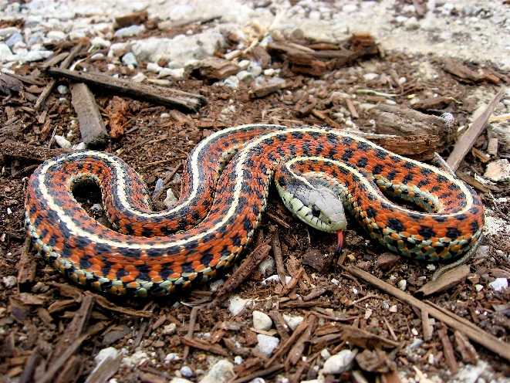
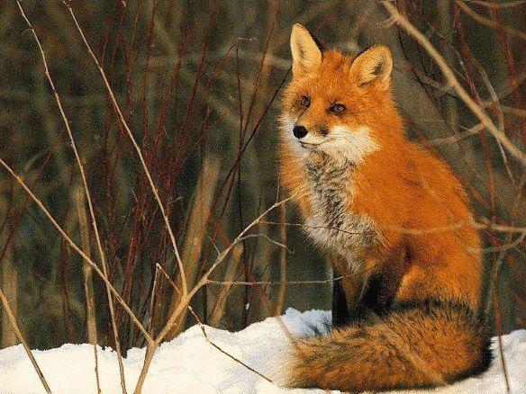
Watch out for these predators!

Slide 19
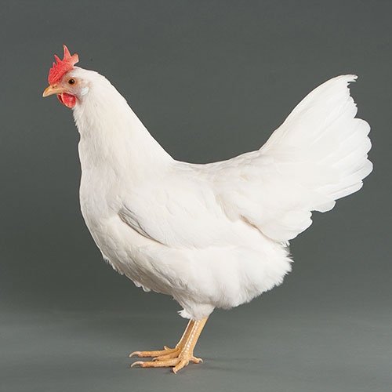
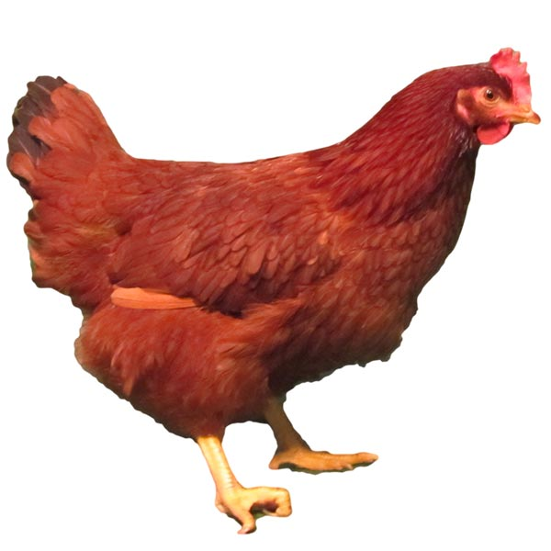
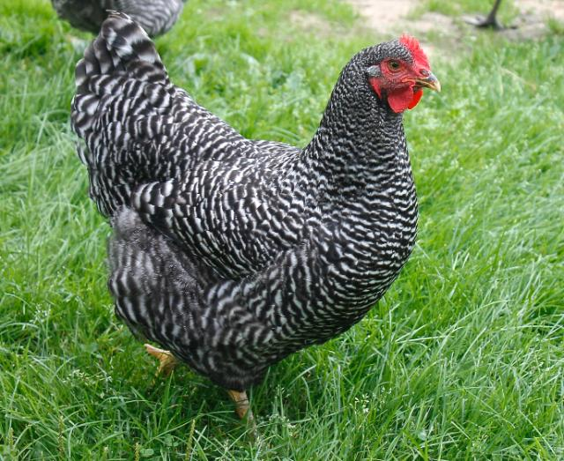
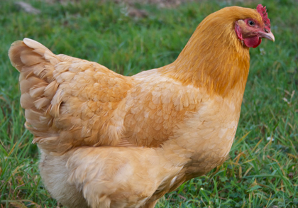
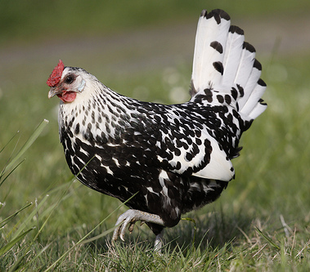
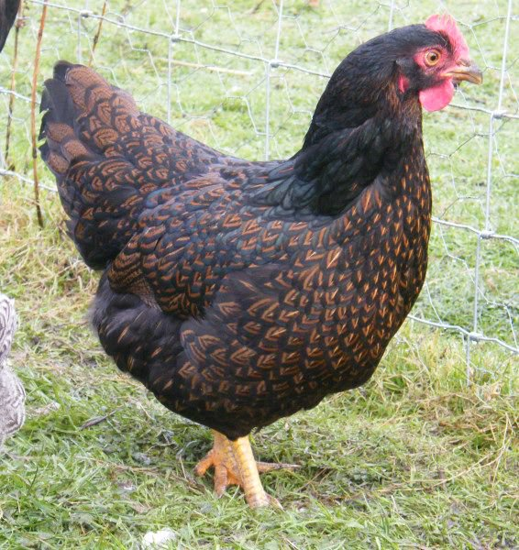
Common laying Breeds
White Leghorn
Rhode Island Red
Sussex
Plymouth Rock
Buff Orpington
Marans
Hamburg
Barnevelder

Slide 20
Exit Ticket
Chickens typically lay for 3-4 years.
Which of the following two choices
tend to decrease with each year?
a. amount of light needed
b. shell quality
c. egg size
d. # of eggs produced each year

Slide 21
Credits:
www.articles.extension.org
www.sites.ext.vt.edu
www.imaginationstationtoledo.org
www.vashonsd.org
www.merckvetmanual.com

